Slide 1

Migrating Knowledge Test of a Driving School to the Cloud
Andrew Cook, Anil Erturk, Scott Zhou, Yu-Che Liu
Team Five Master of Science in Computer Science
City University of Seattle, 98121, USA
Notes:
Hello and welcome to our team project. The team, in order of precedence, consists of myself – Andrew, Anil, Scott, and Spencer. We will be discussing the pillars of the Well-Architected Framework and cloud migration best practices for the non-profit that we chose, the Driving School.

Slide 2
Agenda
Cost Optimization
Conclusion
Key Reference
Q&A
Operational Excellence
Security
Reliability
Performance Efficiency
Notes:
In the order of events we have the pillars of the Well-Architected Framework; operational excellence, security, reliability, performance efficiency, cost optimization, the teams' conclusion, our references, and space for questions and answers.

Slide 3
Operational Execellence
Best practice design principles.
Perform operations as code.
The entire cloud environment can be automated and updated in the AWS script.
Reviewing SOP's for effectiveness and efficiency.
Notes:
The first pillar of the Well-Architected Framework is Operational Excellence
Toward achieving business objectives, continuous improvement of processes and procedures is of the utmost importance. Operational excellence is found by following best practice design principles. The first of these is performing operations as code. This practice is applied here by using the AWS script to make desired changes to the entire cloud environment if you need to. Meaning that the entire cloud environment can be automated and updated in the script.
This has the effect of reducing human error, keeping consistent responses, mechanizing the response execution, and making small, frequent, reversible changes.
Another design principle is to schedule time to review the standard operating procedures validate their effectiveness and efficiency.

Slide 4
Operational Execellence
More design principles
Anticipating failure.
Schedule game days.
Learning from operational failures.
Capturing lessons learned.
Notes:
Another design principle that is very beneficial is anticipating failure. Schedule "game days" to test the company's response to simulations and adversity. This is especially important before a launch and it creates familiarity with the SOP's execution.
The final principle is to learn from all operational failures. Capturing the lessons learned so that the rest of the company doesn't repeat the same mistakes.

Slide 5
Security
Focuses on
Ability to protect information, systems, and assets through risk assessments and mitigation.
Central topics are
Traceability.
Strong IAM.
Automating security.
Applying security at all levels.
Protecting data and keeping people away from data.
Preparing for security events.
Notes:
Security is critical to the cloud infrastructure and this pillar focuses on protecting information, systems, and assets through assessment and mitigation. The main topics here are traceability, a strong Identity and Access Management, automating security, applying security at all levels, protecting data as well as keeping people away from data, and preparing for security events.

Slide 6
Security
Best practice design principles
Have a strong IAM.
Central identity provider (AWS SSO).
Detection (with AWS GuardDuty).
Notes:
Fortunately, there are many tools provided by AWS which cover these parts of this pillar. Identity and Access Management is a core part of AWS and is quite powerful. Another best practice is the central identity provider and AWS Single Sign-On provides this.
Detection is the next crucial part of the architecture and consists of configuration, detection, and investigation. AWS CloudTrail is a fantastic tool for covering this area; providing an event history of account activity, keeping a log of AWS management console activity, command line tools, and others.
AWS GuardDuty is a tool which covers the area f detection; providing a detection for malicious activity.

Slide 7

Security
Design principles (continued).
Use EventBridge to use CloudTrail.
Remediation (with AWS Config).
End of security.
Notes:
Here we have the last bit of security architecture design principles. A very powerful combination of using AWS EventBridge in coordination with CloudTrail activity history to build a scalable rules engine.
The last principle is remediation and AWS Config is an appropriate tool for this. Config will detect alterations to in-scope services and aids in the enforcement of compliance.

Slide 8
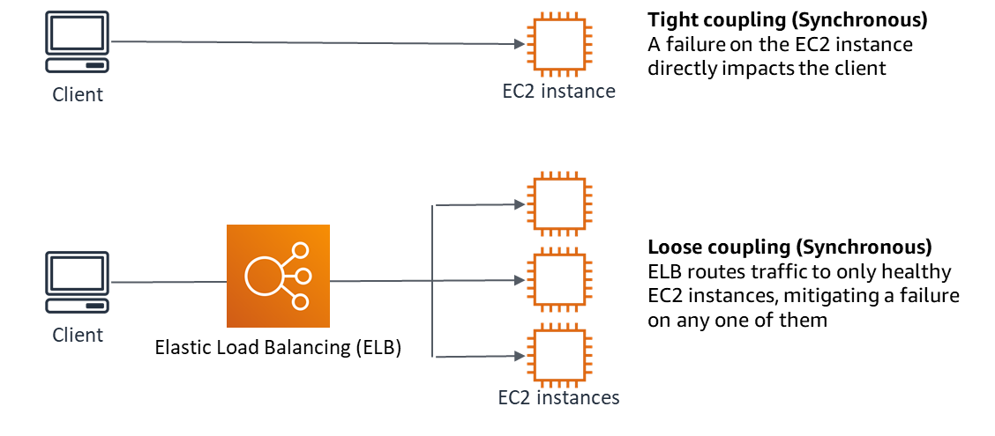
Reliability
Elastic Load Balancing

Slide 9
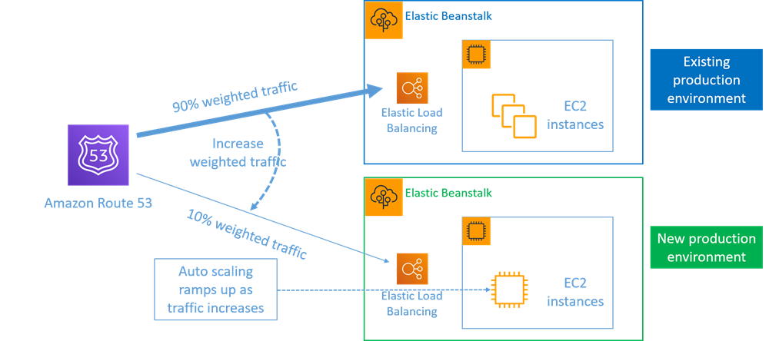
Reliability
Route 53

Slide 10
Performance Efficiency
AWS summarizes performance efficiency as “The ability to use computing resources efficiently to meet system requirements and to maintain that efficiency as demand changes and technologies evolve.” (Belt, 2018).
Notes:
Getting work done is relatively easy when efficiency is not considered. Though this is wasteful and expensive. Engineering is about getting the work done and getting it done efficiently. Servers are inherently prone to either not having enough resources or not using all their resources. So, when it comes to servers, having a shared ecosystem with a big pool is a good idea because if Company A requires more resources, they can request that from the big pool and if Company B has more resources than they need, they can release extra resources into the big pool. Since this adjustment can be done automatically and easily, it can be done continuously over time as the resource demands of users fluctuate.

Slide 11
Performance Efficiency
The democratization of technology refers to technology becoming more accessible. AWS gives small companies like drive-ed access to the same technologies as everyone else.
Notes:
AWS has been opening more and more regions, availability, zones, and edge locations (AWS Regions, n.d). AWS has also been working on making more and more services available in more regions. (AWS Regional Services, n.d).

Slide 12
Performance Efficiency
AWS also allows anyone to set up a server within minutes and even go global within minutes (AWS Advantages, n.d).
Notes:
The fact that AWS has been opening more regions also makes this point stronger. In order to go global, deploy close to end-users, the customers of AWS require regions, availability zones, and edge locations. This also means that there are no performance, bandwidth, and latency trade-offs with the cloud.

Slide 13
Performance Efficiency
AWS cloud also allows for experimenting that companies couldn’t do in real life with physical servers.
Notes:
Cloud offers many choices for every service. It allows customers to try new configurations with the click of a button. And if the customer isn't satisfied, they can simply cancel the service and try another service.

Slide 14
Performance Efficiency
Lack of employees who are skilled in servers, large initial cost, and lack of server infrastructure are big problems for companies trying to set up servers. Cloud offers everyone easy and cheap access to servers.
Notes:
Cloud takes responsibility for many layers of servers, thus decreasing the need for employees who are skilled in those layers of servers. Cloud services most commonly take over responsibility for infrastructure, but this arrangement changes from service to service.

Slide 15
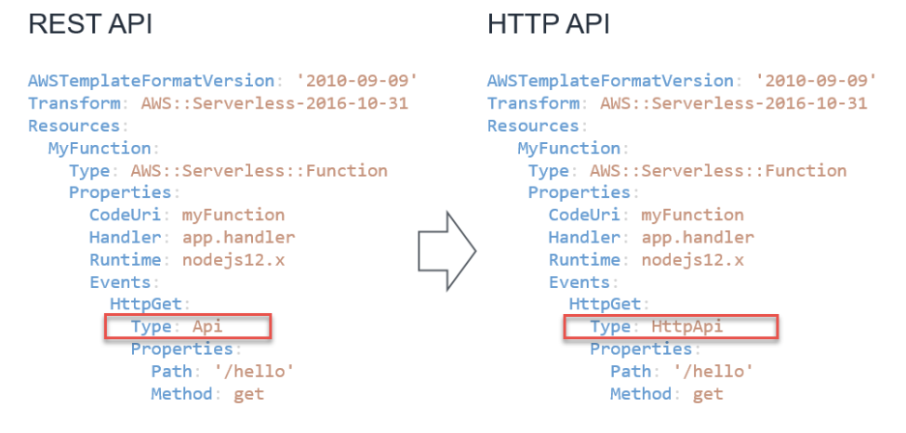
Cost Optimization
Amazon API Gateway- REST APIs, WebSocket APIs, HTTP APIs

Slide 16
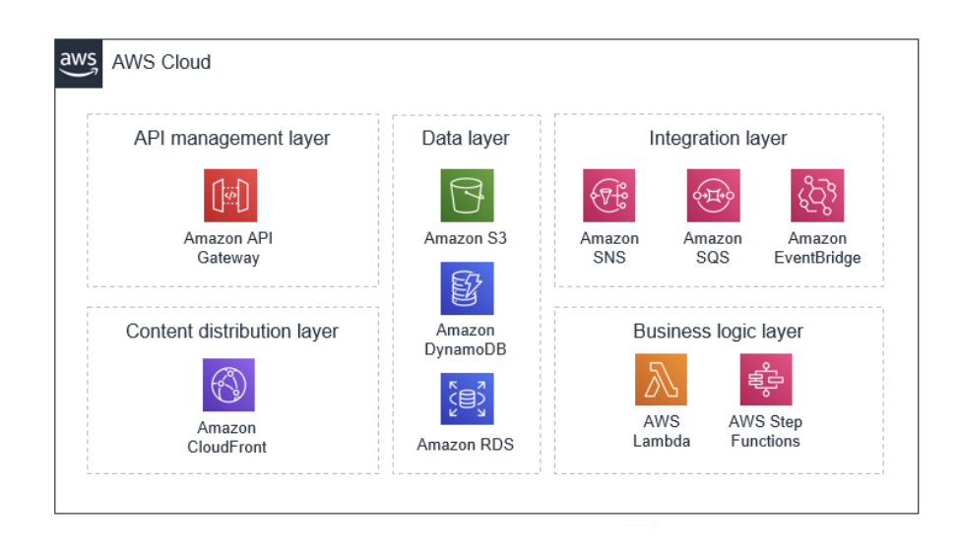
Cost Optimization
Pay for value model
API management layer
Content distribution layer
Data layer
Integration layer
Business logic layer

Slide 17
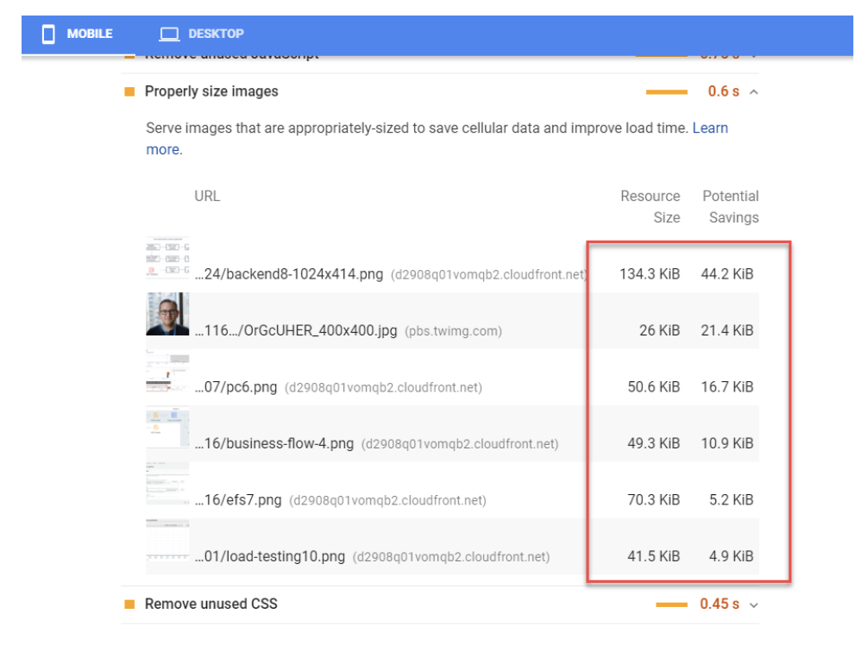
Cost Optimization
Amazon CloudFront-216 Points of Presence.
Resizer Lambda function

Slide 18
Cost Optimization
Billing models vary by service and Region
Data access
Storage requirements
Cost-effective to store binary data in S3

Slide 19
Cost Optimization
Integration Layer-
Amazon SQS, Amazon SNS, Amazon EventBridge
Combine messages
Filter messages

Slide 20
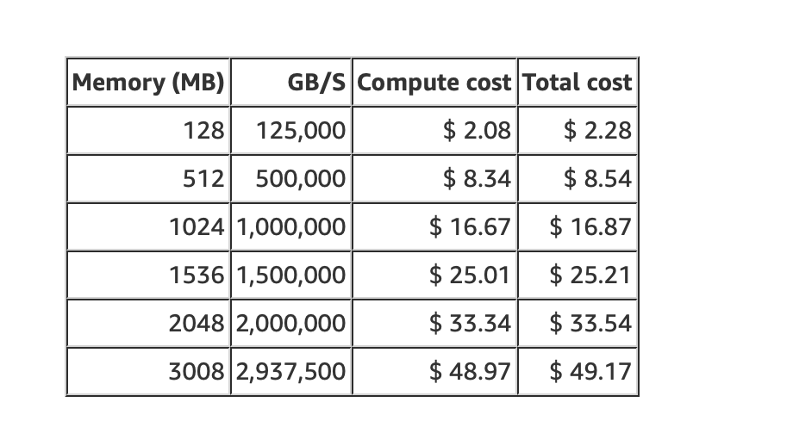
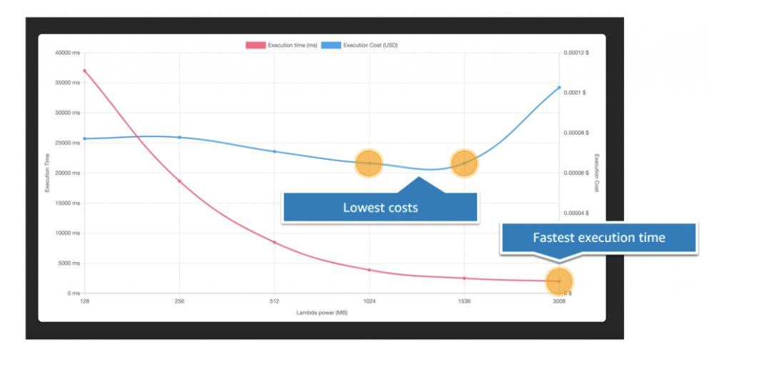
Cost Optimization
Lambda- On-demand service billed by requests and GB seconds.
Memory allocation between 128MB and 3008MB.
AWS Lambda Power Tuning tool.

Slide 21
Conclusion
Web Application backends
Serverless applications
Pay-per-value model
Design-choices and service configurations

Slide 22
Key Reference
Beswick, J. (2020, October 19). Optimizing the cost of serverless web applications. AWS Compute Blog. https://aws.amazon.com/blogs/compute/optimizing-the-cost-of-serverless-web-applications/
AWS Reliability Pillar AWS Well-Architected Framework. (n.d.).
https://docs.aws.amazon.com/wellarchitected/latest/reliability-pillar/wellarchitected-reliability-pillar.pdf#reliability
Carlson, B., Steele, J., King, R., & Mitzsimons, P. (2020, July). A Well Architected Framework: Operational Excellence Pillar (Rep.).
Potter, B., Shinn, B., Johnson, B., Pogson, B., Boyd, D., &amp; Walker, D. (2020, July). AWS Well-Architected Framework: Security Pillar (Rep.).
https://docs.aws.amazon.com/wellarchitected/latest/security-pillar/wellarchitected-security-pillar.pdf#welcome
Thakkar, M., Brooker, M., &amp; Surkatty, O. (2021, February 15). Security Overviewof AWS Lambda. https://docs.aws.amazon.com/whitepapers/latest/security-overview-aws-lambda/security-overview-aws-lambda.pdf#security-overview-aws-lambda
Belt, D. (2018). The 5 Pillars of the AWS Well-Architected Framework https://aws.amazon.com/blogs/apn/the-5-pillars-of-the-aws-well-architected-framework/
AWS Regional Services. (n.d). AWS Regional Services https://aws.amazon.com/about-aws/global-infrastructure/regional-product-services/
AWS Advantages. (n.d). Six Advantages of Cloud Computing. https://docs.aws.amazon.com/whitepapers/latest/aws-overview/six-advantages-of-cloud-computing.html

Slide 23


Q&A

